Slide 1
Normalization (Cont.)

Slide 2
Lecture - Objectives
First Normal Form
Partial Dependency
Second Normal Form
Transitive Dependency
Third Normal Form

Slide 3
First Normal Form
A relation that has a primary key and in which there are no repeating groups.
No multivalued attributes
A primary key has been defined
All relations are in 1st Normal Form

Slide 4
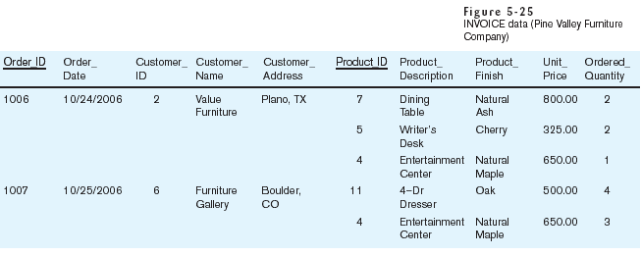
Table with multivalued attributes, not in 1st normal form
Note: this is NOT a relation

Slide 5
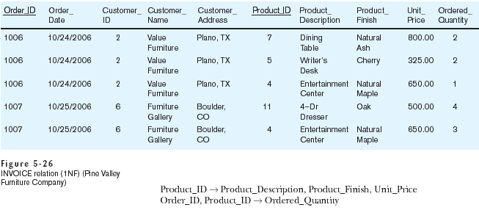
Table with no multivalued attributes and unique rows, in 1st normal form
Note: this is relation, but not a well-structured one

Slide 6
Partial Functional Dependency
A functional dependency in which one or more nonkey attributes are functionally dependent on part (but not all) of the primary key.

Slide 7
Second Normal Form
1NF PLUS every non-key attribute is fully functionally dependent on the ENTIRE primary key
Every non-key attribute must be defined by the entire key, not by only part of the key
No partial functional dependencies

Slide 8
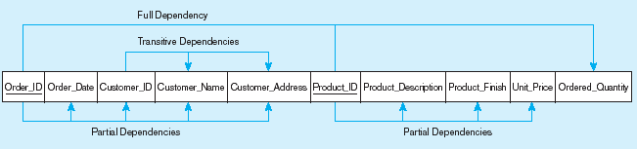
Functional dependency diagram for INVOICE
Order_ID ➔ Order_Date, Customer_ID, Customer_Name, Customer_Address
Customer_ID ➔ Customer_Name, Customer_Address
Product_ID ➔ Product_Description, Product_Finish, Unit_Price
Order_ID, Product_ID ➔ Order_Quantity
Therefore, NOT in 2nd Normal Form

Slide 9
To convert a relation with partial dependencies to second normal form, the following steps are required:
1. Create a new relation for each primary key
attribute (or combination of attributes) that
is a determinant in a partial dependency.
That attribute is the primary key in the new
relation.
2. Move the nonkey attributes that are only
dependent on this primary key attribute (or
attributes) from the old relation to the new
relation.

Slide 10
Figure 5-28 Removing partial dependencies
Getting it into Second Normal Form
Partial dependencies are removed, but there are still transitive dependencies

Slide 11
Transitive Dependency
A functional dependency between the primary key and one or more nonkey attributes that are dependent on the primary key via another nonkey attribute.
For example, there are two transitive dependencies in the CUSTOMER ORDER relation.
OrderID → CustomerID → CustomerName
OrderID → CustomerID → CustomerAddress

Slide 12
Transitive dependencies in CUSTOMER ORDER relation

Slide 13
Third Normal Form
2NF PLUS no transitive dependencies (functional dependencies on non-primary-key attributes)
Solution: Non-key determinant with transitive dependencies go into a new table; non-key determinant becomes primary key in the new table and stays as foreign key in the old table

Slide 14
REMOVING TRANSITIVE DEPENDENCIES
Three-step procedure:
1. For each nonkey attribute (or set of attributes)
that is a determinant in a relation, create a new
relation. That attribute (or set of attributes)
becomes the primary key of the new relation.
2. Move all of the attributes that are functionally
dependent only on the primary key of the new
relation from the old to the new relation.
3. Leave the attribute that serves as a primary key
in the new relation in the old relation to serve as
a foreign key that allows you to associate the
two relations.

Slide 15
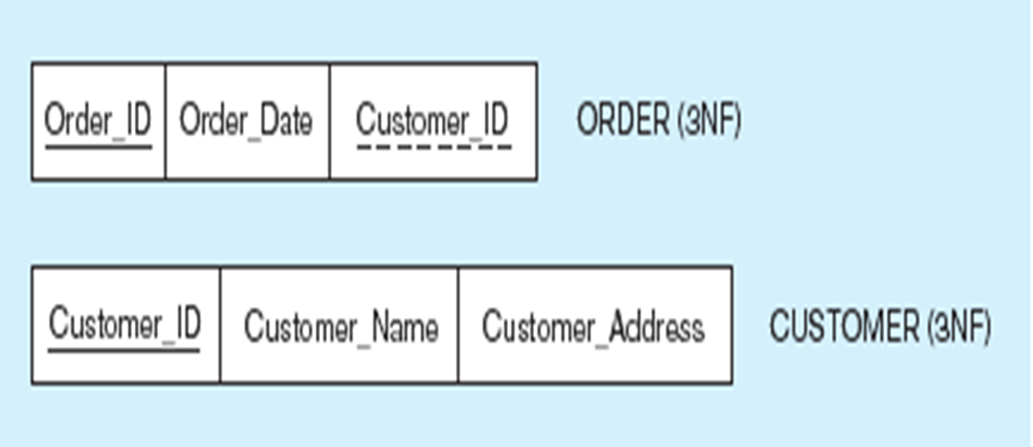
Figure: Removing transitive dependencies
Getting it into Third Normal Form
Transitive dependencies are removed

Slide 16
Thanks

